Slide 1

Ahsanullah University of Science & Technology Department of Computer Science & Engineering
University Management System
Database Lab (CSE 3104)

Slide 2
Submitted To
Mr. Mohammad Moinul Hoque
Mr. Mir Tafseer Nayeem
Prepared By:
Md. Tanvir Rouf Shawon ID: 16.01.04.138
Jeba Maliha ID: 16.01.04.143

Slide 3
Project Report
Name of the project :
University Management System

Slide 4
Project Objectives
The Main target of this project is to make a organized database of a university.
To insert new student or Instructor data in the database and retrieve them for various purpose.
Another objective of the system is to maintain the university information like student’s result, admission etc.
It can also maintain the Instructor’s information for administrative purpose.

Slide 5
Features of the project
Show the Instructor’s name according to their department.
Show the Course title ,course credit and department name for all department.
Show the existing departments of the university.
Show all the courses of CSE department
Show all the courses of EEE department
Show all the 3 credit courses of CSE department
Login of normal user
Changing the password of a registered user.

Slide 6
Show the total credit of CSE department
Show the total credit of all department.
Show the result of student.
Show the result of a student in a particular semester
Show the semester wise Courses they have taken
Show the course Teacher students have in their course
Student’s login
Student’s password change
Show all the information of Students
Show all the information of Department

Slide 7
Show all the information of Instructors.
Show all the information of Instructors of EEE department.
Show all the information of Courses
Show all the information of Sections
Show all the information of Enrollment.
Show the name and salary of the Instructors whose salary is 50000 or greater.
Show the name and salary of the Instructors whose salary is 50000 or greater and department is CSE.
Show all the information of Courses which are taken by a particular instructor.

Slide 8
Show the name of the Instructor who are currently in service.
Show the name of the Instructor who have left the university.
Show the serving time and name of a particular Instructor who have left.
Increase Instructor's salary by 10 percent whose salary is lower or equal to 30000
Show the courses taken by a student.
Show the courses of CSE department.
Show the highest Salary among the Instructors
Show the lowest Salary among the Instructors
Show the courses that were offered in Spring 16 but not Fall 15.

Slide 9
Show the department wise Maximum Salary
Show the total credit hour of each department
Show the section wise student in Spring 16 semester
Show the students with name starting with B
Show the student whose address is Sylhet
Show the students who have age between 18 and 22
Show the student who use Robi Sim
Show the student whose phone number ends with 2
Show the student who have got A+
Show the instructor who take more than 2 courses
Admin’s login in the database.

Slide 10
Show the number of registered User
Show the number of registered Student
Show all the information about the registered User
Show the registered User
Show the student who attend class at a particular room

Slide 11
Types of Users
# Normal Users
In this university management system a normal user can on ly see some limited information like Instructor’s list, department list, Courses according to the departments etc.
# Students (Private User)
Students are the private user of this system. They can know their result of different semester, their marks, their course teacher etc. We can say that they are the users who only can see their own information and all the information a general user can get.

Slide 12
# ADMIN
Admin is the controller of the university management system. An administrative person will act as an admin . He can perform a lot of action on the database . Everything is under control of him. He can Enter new Instructor, new Students, New sections and what not.

Slide 13
Feature grouping according to the Users
# Normal User
Show the Instructor’s name according to their department.
Show the Course title ,course credit and department name for all department.
Show the existing departments of the university.
Show all the courses of CSE department
Show all the courses of EEE department
Show all the 3 credit courses of CSE department
Login of normal user
Changing the password of a registered user.
Show the total credit of CSE department
Show the total credit of all department.

Slide 14
# Students (Private Users)
Show the result of student.
Show the result of a student in a particular semester
Show the semester wise Courses they have taken
Show the course Teacher students have in their course
Student’s login
Student’s password change

Slide 15
# Admin
Show all the information of Students
Show all the information of Department
Show all the information of Instructors.
Show all the information of Instructors of EEE department.
Show all the information of Courses
Show all the information of Sections
Show all the information of Enrollment.
Show the name and salary of the Instructors whose salary is 50000 or greater.
Show the name and salary of the Instructors whose salary is 50000 or greater and department is CSE.
Show all the information of Courses which are taken by a particular instructor.

Slide 16
Show the name of the Instructor who are currently in service.
Show the name of the Instructor who have left the university.
Show the serving time and name of a particular Instructor who have left.
Increase Instructor's salary by 10 percent whose salary is lower or equal to 30000
Show the courses taken by a student.
Show the courses of CSE department.
Show the highest Salary among the Instructors
Show the lowest Salary among the Instructors
Show the courses that were offered in Spring 16 but not Fall 15.

Slide 17
Show the department wise Maximum Salary
Show the total credit hour of each department
Show the section wise student in Spring 16 semester
Show the students with name starting with B
Show the student whose address is Sylhet
Show the students who have age between 18 and 22
Show the student who use Robi Sim
Show the student whose phone number ends with 2
Show the student who have got A+
Show the instructor who take more than 2 courses
Admin’s login in the database.

Slide 18
Show the number of registered User
Show the number of registered Student
Show all the information about the registered User
Show the registered User
Show the student who attend class at a particular room.

Slide 19
Names of the Entities with primary key
Table Name | Primary Key
Login | log_id
Instructor | i_id
Student | s_id
Section | sec_id
Department | d_id
Course | c_id
Enrollment | s_id,c_id

Slide 20
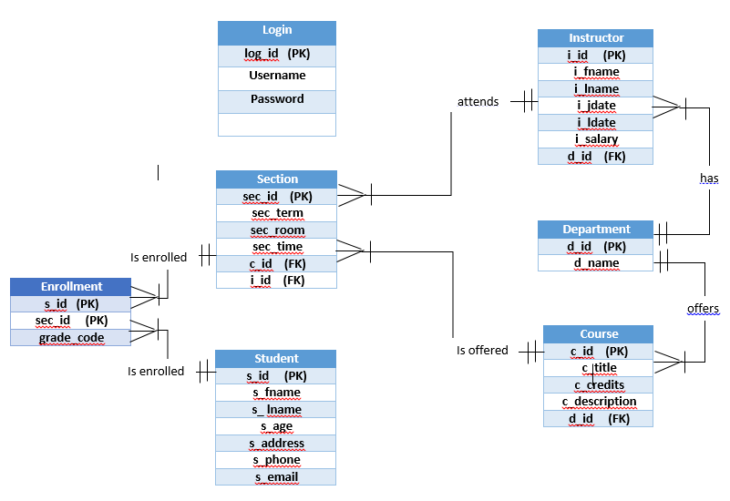
Entity Relationship Diagram (ERD)

Slide 21
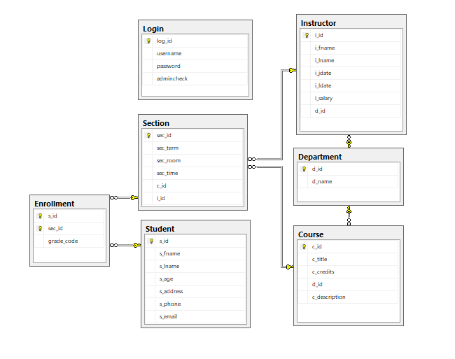
Database Diagram

Slide 22
SQL Queries Grouped Under Different Types Of Users:
Insert Into Login
Values ('Jamal','12345',1),
('Kamal','123',0),
('Chapel','123',0),
('Rahim','1234',2);
Insert Into Student
Values ('Jack', 'Johnson',21,'Dhaka', '01723423423', 'jack@gmail.com'),
('Dolly', 'Denver',22,'Dhaka', '01712345678', 'dolly@gmail.com'),
('Helmut', 'Ziegler',21,'Comilla','01898765432', 'helmut@yahoo.com'),
('Robert', 'Thompson',24,'Khulna','01808975643', 'robert@gmail.com'),
('Jeffrey', 'Petersen',23,'Sylhet', '01773439315', 'petersen@yahoo.com'),
('Jack', 'Pirate',22,'Chittagong','01712321124', 'pirate@gmail.com'),
('Barb', 'Wire',21, 'Comilla','01709876789','barb@yahoo.com'),
('Roberta', 'Strong',24, 'Sylhet','01827645238', 'strong@gmail.com'),
('Heather', 'Black',22,'Dhaka', '01921674523','black@yahoo.com'),
('Erik', 'Bjornsen',23,'Khulna', '01990675634', 'erik@yahoo.com');

Slide 23
Insert Into Department
Values ('CSE'),
('CIVIL'),
('EEE'),
('MECHA'),
('IPE'),
('BBA'),
('TEX');
Insert Into Instructor
Values ('Bill', 'Smith', '1995-12-21','2014-07-02',50000,20001),
('James', 'Peterson', '1997-03-12','2018-06-12',35000,20001),
('Adam', 'Thompson', '1998-04-15',null,60000,20002),
('Janetta', 'Oakley', '2001-02-13',null,50000,20003),
('Robin', 'Dexter', '2003-05-23',null,45000,20002),
('Annie', 'Jackson', '2004-06-02',null,30000,20004),
('Philip', 'Petrovsky', '2006-02-27',null,50000,20005),
('Anastasia', 'Scott', '2013-03-12',null,60000,20001);

Slide 24
Insert Into Course
Values ('EEE201',3, 20003, 'Microeconomics'),
('CIVIL301',3, 20002, 'Building Materials'),
('EEE302',3,20003, 'Power Electronics'),
('EEE303',4,20003 , 'Circuit Setup'),
('CSE201', 4,20001, 'Algorithms I'),
('CSE202', 3,20001, 'Data Stucture'),
('MECHA203',3,20004, 'Fluid Mechanics'),
('MECHA302',2,20004, 'Statistical Mathematics');
Insert Into Section
Values ('Spring16','7A05','10.30', 40001,30005),
('Fall16','7A05','01.00',40002,30004),
('Fall17','6A03', '12.30',40007,30007),
('Spring18','6A02', '12.30',40008,30007),
('Fall17','5A04', '11.00',40006,30002),
('Spring16','5A04', '11.00',40003,30005),
('Spring18','5A02', '11.00',40005,30003);

Slide 25
Insert Into Enrollment
Values (10001,50001,'A+'),
(10001,50006,'A'),
(10002,50001,'B-'),
(10002,50006,'A'),
(10003,50003,'A+'),
(10003,50005,'A+'),
(10004,50003,'B+'),
(10004,50005,'B'),
(10005,50002,'A-'),
(10005,50004,'B-'),
(10006,50004,'C'),
(10006,50007,'F'),
(10008,50003,'D'),
(10009,50003,'F'),
(10007,50001,'A-');

Slide 26
# Normal User
--> 1
SELECT i_fname +' '+ i_lname as Name_of_the_Faculties,d_name as Department_Name
from Instructor I,Department D where I.d_id=D.d_id
-->2
SELECT c_title as Course_Title,c_description as Course_Name, c_credits as Course_credit, d_name as Department_Name
from Course C,Department D where C.d_id=D.d_id
-->3
SELECT d_name as Department_Name FROM Department
-->4
SELECT c_title as Course_Name,c_credits as Credit
FROM Course C,Department D
where C.d_id=D.d_id and d_name='CSE'
-->5
SELECT c_title as Course_Name,c_credits as Credit
FROM Course C,Department D
where C.d_id=D.d_id and d_name='EEE'

Slide 27
-->6
SELECT c_title as Course_Name,c_credits as Credit
FROM Course C,Department D
where C.d_id=D.d_id and d_name='CSE' and c_credits=3
-->7
Select username from Login where username='Kamal' and password ='123' and admincheck=0
-->8
Update Login set password='1234' where username='Chapel'
-->9
Select sum(C.c_credits) as Total_Credit_Of_CSE from Course C,Department D
where C.d_id=D.d_id and D.d_name='CSE'
-->10
Select D.d_name as Departpent_Name, sum(C.c_credits) as Total_Credit
from Course C,Department D
where C.d_id=D.d_id group by D.d_name

Slide 28
# Students (Private Users)
-->1 Result of a student
SELECT st.s_id as Student_ID, c_description as Course_Name,grade_code as Grade
FROM Enrollment E,Section S,Course C,Student St
where E.sec_id=S.sec_id and S.c_id=C.c_id and E.s_id=St.s_id and st.s_id = 10001
-->2 Result of a student in a particuler semester
SELECT st.s_id as Student_ID, c_description as Course_Name,grade_code as Grade
FROM Enrollment E,Section S,Course C,Student St
where E.sec_id=S.sec_id and S.c_id=C.c_id and E.s_id=St.s_id and st.s_id = 10007 and S.sec_term='Spring16'
-->3 Semester wise Courses they have taken
SELECT c_description as Course_Name,S.sec_term as Semester
FROM Enrollment E,Section S,Course C,Student St
where E.sec_id=S.sec_id and S.c_id=C.c_id and E.s_id=St.s_id and st.s_id = 10001
-->4 Course Teacher they have in their course
SELECT c_description as Course_Name,I.i_fname as Instructor
FROM Enrollment E,Section S,Course C,Student St,Instructor I,Department D
where E.sec_id=S.sec_id and S.c_id=C.c_id and E.s_id=St.s_id and I.d_id=D.d_id and D.d_id=C.d_id and st.s_id = 10001
-->5 Student Login
Select username from Login where username='Jamal' and password ='12345' and admincheck=1
-->6
Update Login set password='1234' where username='Chapel'

Slide 29
# ADMIN
-->1
SELECT * from Student
-->2
SELECT * from Department
-->3
SELECT * from Instructor
-->5
SELECT * from Instructor I,Department D where I.d_id=D.d_id and D.d_name='EEE'
-->6
SELECT * from Course
-->7
SELECT * from Section
-->8
SELECT * from Enrollment
-->9
SELECT i_fname+' '+ i_lname AS Name_Of_The_Instructor,i_salary AS Salary FROM Instructor WHERE i_salary>=50000
-->10
SELECT i_fname+' '+ i_lname AS Name_Of_The_Instructor,i_salary AS Salary,d_name As Department_name
FROM Instructor I,Department D
WHERE i_salary>=50000 and I.d_id=D.d_id and d_name='CSE'

Slide 30
-->11
SELECT c_description as Course_Name FROM Course C,Section S,Instructor I
where S.c_id=C.c_id and S.i_id=I.i_id and i_fname='Bill'
-->12 Current Instructor
SELECT i_fname+' '+ i_lname AS Name_Of_The_Instructor FROM Instructor where i_ldate is NULL
-->13 Instructors who have left
SELECT i_fname+' '+ i_lname AS Name_Of_The_Instructor FROM Instructor where i_ldate is not NULL
-->14 Serving Time of a teacher
SELECT DATEDIFF(YEAR,i_jdate,i_ldate) FROM Instructor where i_fname='Bill'
-->15 Increse Instructor's salary by 10 percent whose salary is lower or equal to 30000
UPDATE Instructor set i_salary=i_salary+i_salary*.10 where i_salary<=30000
-->16 Course That are taken by a Student
SELECT c_description as Course_Name FROM Enrollment E,Section S,Course C,Student St
where E.sec_id=S.sec_id and S.c_id=C.c_id and E.s_id=St.s_id and st.s_fname='Jack'
-->17 Course of CSE
SELECT c_description FROM Course where c_title like 'CSE%'
-->18 Highest Salary among the Instructors
SELECT max(i_salary) from Instructor
-->19 Lowest Salary among the Instructors
SELECT min(i_salary) from Instructor
-->20 Courses that were offered in Spring 16 but not Fall 15\
SELECT c_description as Course_Name FROM Section S,Course C
where S.c_id=C.c_id and S.sec_term='Spring16' and S.sec_term !='Fall15'

Slide 31
-->21 Department wise Maximum Salary
SELECT D.d_name as Department, max(i_salary) from Instructor I,Department D
where I.d_id=D.d_id Group by D.d_name
-->22 Total credit hour of each department
SELECT D.d_name as Department, sum(c_credits) from Course C,Department D
where C.d_id=D.d_id Group by D.d_name
-->23 Section wise student in Spring 16 semister
SELECT S.sec_id,count(St.s_id) from Student St,Enrollment E, Section S
where S.sec_term='Spring16' and St.s_id=E.s_id and E.sec_id=S.sec_id
group by S.sec_id
-->24 Student with name starting with B
Select s_fname+' '+s_lname as Name from Student where s_fname like 'B%'
-->25 Student whose address is Sylhet
Select s_fname+' '+s_lname as Name from Student where s_address='sylhet'
-->26 Student who have age between 18 and 22
Select s_fname+' '+s_lname as Name from Student where s_age between 18 and 22
-->27 Student who use Robi Sim
Select s_fname+' '+s_lname as Name from Student where s_phone like '018%'
-->26 Student whose phone number ends with 2
Select s_fname+' '+s_lname as Name from Student where s_phone like '%2'

Slide 32
-->27 Student who have got A+
Select distinct s_fname+' '+s_lname as Name from Student St, Enrollment E, Section S
where St.s_id=E.s_id and E.sec_id=S.sec_id and E.grade_code='A+'
-->28 Instructor who take more than 2 courses
SELECT I.i_fname as Instructor_Name, count(S.c_id) from Instructor I,Section S
where I.i_id=S.i_id Group by I.i_fname having count(S.c_id)>=2
-->29 Admin Login
Select username from Login where username='Rahim' and password ='1234' and admincheck=2
-->30 Number of registered User
Select count(log_id) from Login where admincheck=0 or admincheck=1
-->31 Number of registered Student
Select count(log_id) from Login where admincheck=1
--> 32 Know all the information about the registered User
Select * from Login
-->33 Show the registered User
Select username from Login where admincheck=1 or admincheck=0
-->34 Student who attend class at a particular room
select s_fname from Student where s_id in
(select s_id from Enrollment where sec_id in
(Select sec_id from Section where sec_room='7A05'))

Slide 33
Project Limitations
The system is not perfect for an university. It needs some improvement to use perfectly.
The employee table is not added in this database.
Instead of date of birth age is given in Student table. So we have to increase this column by one every year.
Result is only given in grade system but marks should be included for better understanding.

Slide 34
Conclusion & Future Work
Future Work :
We can add some table like employee, hall etc. in this database and implement it completely. This project has no User Interface. So we can implement a User interface with Java or PHP. We can use it as a website database for an university also.

Slide 35
Conclusion:
As this project is a MSSql Database project. It can be used in different types of User interfaced project like Java. This is a portable project as it is only created by some sql code. This project is also efficient as we have attached all the query possible for an university management system. We have used a low amount of resources as we have not used anything without SQL server management studio. This is also a user friendly system for all types of user. At the end we can say that it is a complete system for a university.

